Slide 1
College Admissions Breakfast
Jessica Brousseau (A-L)
Sandra Miguez-Fernandes (M-Z)

Slide 2
Senior Planning Questionnaire
Found in the “About Me” section of the students’ Naviance pages
Used to schedule future planning meetings and write detailed letters of recommendation
Notes:
Sandra

Slide 3
Remind 101
Notes:
Jessica

Slide 4
Profile
For weighted/unweighted GPA and class rank, please see Mrs. Hart in the Counseling Office
Notes:
Jessica

Slide 5
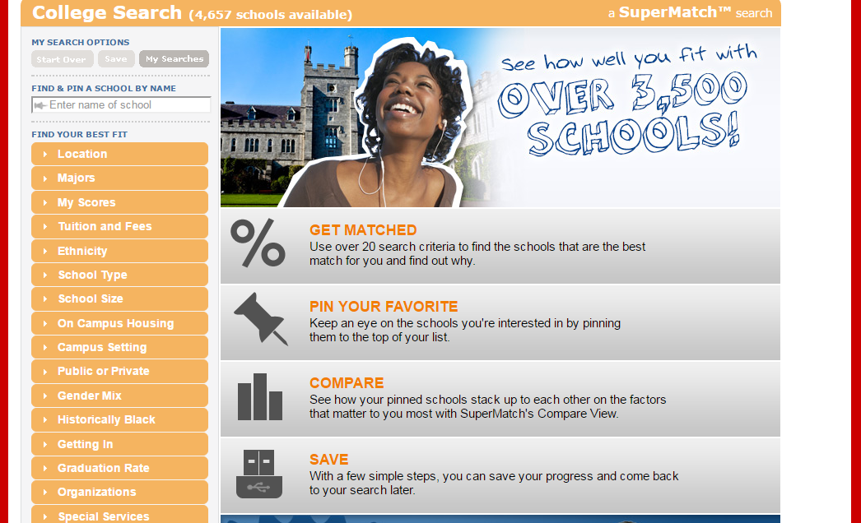
Naviance- College Search
Super Match
Notes:
Sandra

Slide 6
Naviance & Common App
At this point, seniors should have:
Added schools to “Schools I’m Applying To”
Created a Common App account
Linked their Common App and Naviance accounts
Notes:
Sandra

Slide 7
The Application
A complete application involves:
Common App or noncommon application
Essay and supplemental writings
Application fee
Transcript request
Test score request
via CollegeBoard (SAT) or ACT (2 weeks prior to college deadline)
Subject tests if applicable
Letters of recommendation
Give teacher resume and deadlines
Notes:
Jessica

Slide 8
The Application- Community College
Complete application
Application fee
Transcript request
Accuplacer test
Scheduled by student
Notes:
Sandra

Slide 9
Essay
Students are currently completing their senior essay in their English IV classes
Some schools will require supplemental writings as a piece of their application
Ask your English teacher to look over your essays before submission
Notes:
Jessica

Slide 10
Letters of Recommendation
Students will receive 3 letters of recommendation
1- School Counselor
2- Teachers
Students must request letters of recommendation from their teachers
Personally- resume & deadlines
Naviance- request
Notes:
Sandra

Slide 11
SAT- CollegeBoard
Test Date | Registration Deadline
November 5, 2016 | October 7
December 3, 2016 | November 3
SAT with writing $54.50
Subject Tests $26
Notes:
Jessica

Slide 12
ACT
Test Date | Registration Deadline
October 22, 2016 | September 30 (Late)
December 10, 2016 | October 4
ACT with writing $56.50
Notes:
Sandra

Slide 13
Sending Your Scores
Students must request that their scores be sent to each school 2 weeks prior to the school’s deadline
CollegeBoard (SAT)- $12 per report
ACT- $12 per report
* If you are registering for a future test date, you will have the opportunity to request 4 free score reports
Notes:
Sandra

Slide 14
What Next?
Community Service Hours
Seniors will need to have 30 hours of community service completed prior to graduation
Demonstrated Interest
College reps
College visits
Current Courses
Colleges will receive final student grades at the end of the year
Keep up your grades!
Notes:
Jessica

Slide 15
What Next?
As students receive acceptance letters, please have them bring them to the Counseling Office so that the department can makes copies
Useful for:
Data tracking
Helping future students
Enter admissions decisions into Naviance
Notes:
Jessica

Slide 16
FAFSA
Free Application for Federal Student Aid:
Determines Pell Grant and Federal Loan eligibility
Create a FSA ID not a PIN
Opens October 1
Notes:
Sandra

Slide 17
CSS Profile
Many schools require that students complete the CSS Profile in addition to FAFSA to determine financial awards
Check your schools to determine CSS profile deadlines!
Notes:
Sandra

Slide 18
Scholarships
There are a number of scholarships available to students via the “Scholarship List” in Naviance
Students who need transcripts as a piece of their scholarship application must see Ms. Hart in the Counseling Office
Notes:
Jessica

Slide 19
Questions?

