Slide 1
Creating a College Board Account

Slide 2
Why Have an Account?
Your College Board account will allow you to:
See your upcoming PSAT scores
Find free test prep for the SAT
Send your SAT scores to colleges

Slide 3
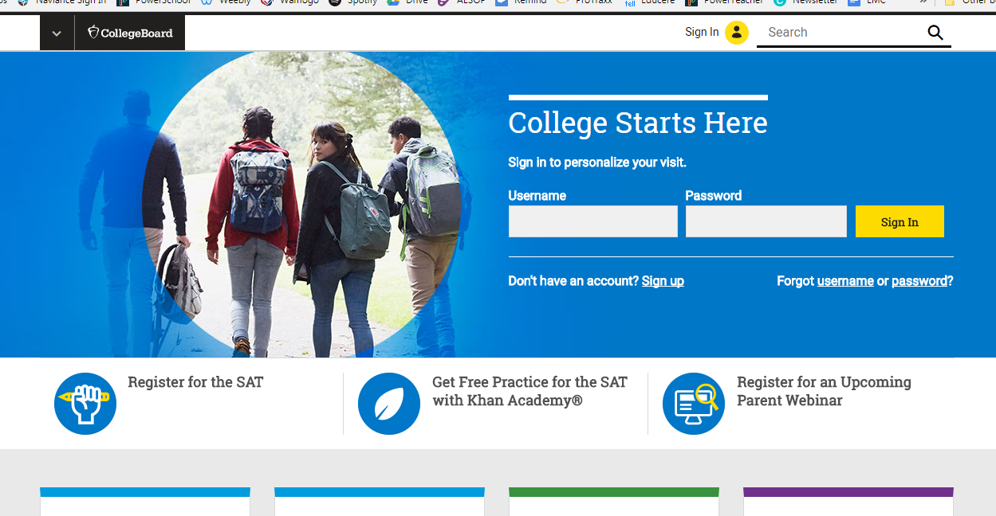
Step 1:
Go to www.CollegeBoard.org
Click on “Sign Up”

Slide 4
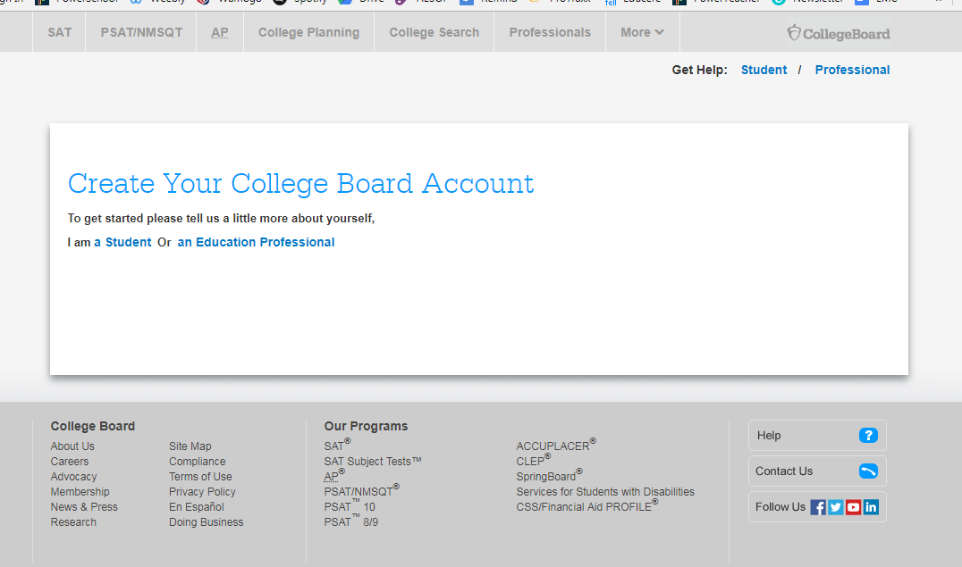
Step 2:
Indicate you are “a Student” by clicking on that link

Slide 5
Step 3:
Fill in the required General Student Information, including your:
First and last name
Gender
Date of birth
Email address (use rsd6 email)
Graduation (Gr 9: June 2021, Gr 10: June 2020)
Zip code
School name (Wamogo Regional High School)

Slide 6
Step 4:
Create Username and Password
IMPORTANT:
The username should be your last name, the first two initials of your first name, and the year you are graduating
The password should be your birthdate (the typed month, beginning with a capital letter, and the numbered day)
Sample: brousseauje2020
March12

Slide 7
Step 5:
Complete your Parent Information, if possible
Agree to the terms and conditions
Click “Next”

Slide 8
Step 6:
Confirm your information by checking the boxes next to your name, gender, and date of birth
Click “Confirm”
Then you’re DONE!

Slide 9
What Can You Do Now?
Now that you have a College Board account, you can:
Practice with Khan Academy
More information coming soon!
Explore colleges and careers
Make your own individualized academic plan
And more!

Slide 10
If you have any questions, contact your counselor!
Ms. Brousseau
Students, A-L
jbrousseau@rsd6.org
Mrs. Fernandes
Students, M-Z
smiguez-fernandes@rsd6.org

